Slide 1
Introduction to MR
Robert Frost
Thanks for images/animations provided by Dylan Tisdall

Slide 2
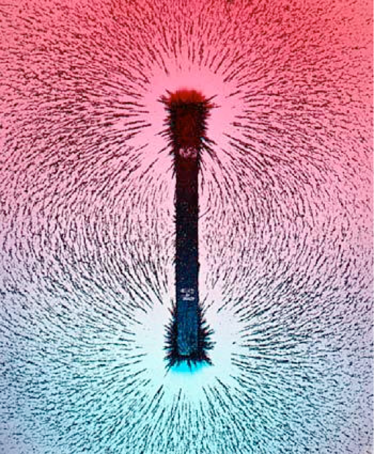
MRI signal from protons
Nuclei with odd number of protons/neutrons have ”spin” or angular momentum
“spin” + charge → magnetic moment
Bar magnets have magnetic moment
+
H₁

Slide 3
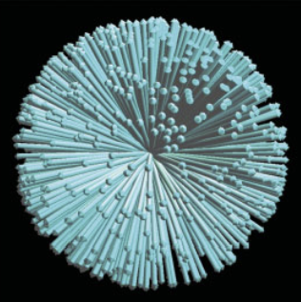
Lars Hanson, 2008

Slide 4
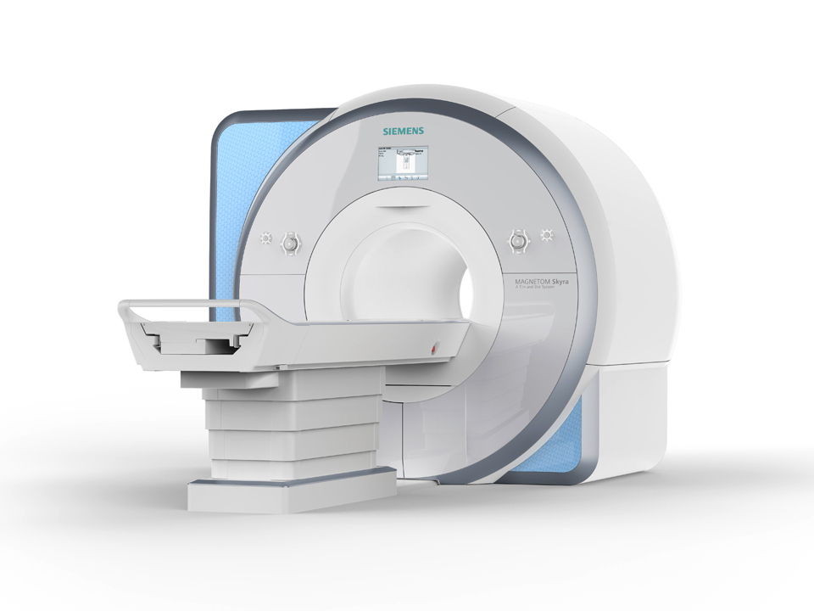
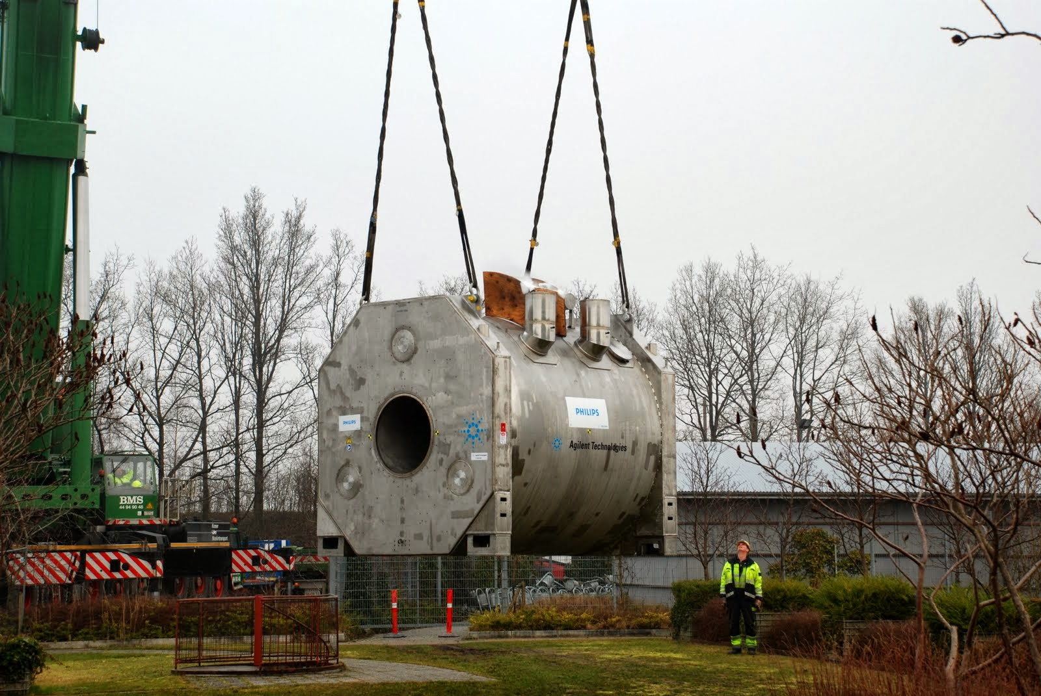

Slide 5
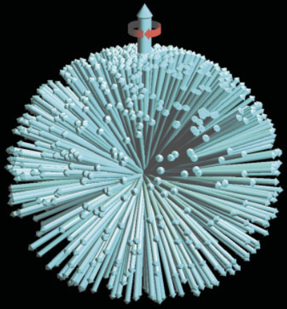
“B₀”, z direction
“Precession”
Net magnetisation M
Lars Hanson, 2008

Slide 6
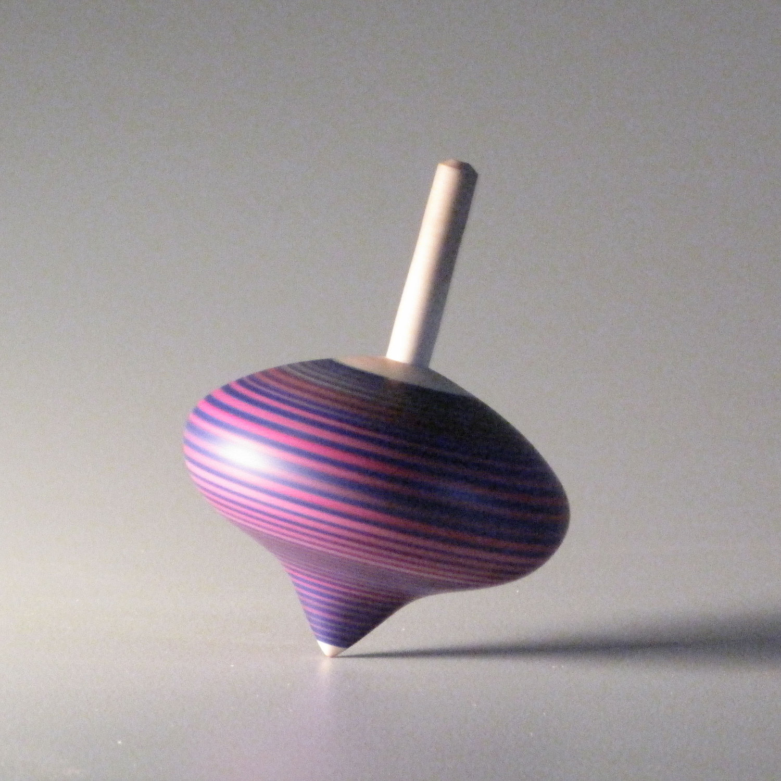
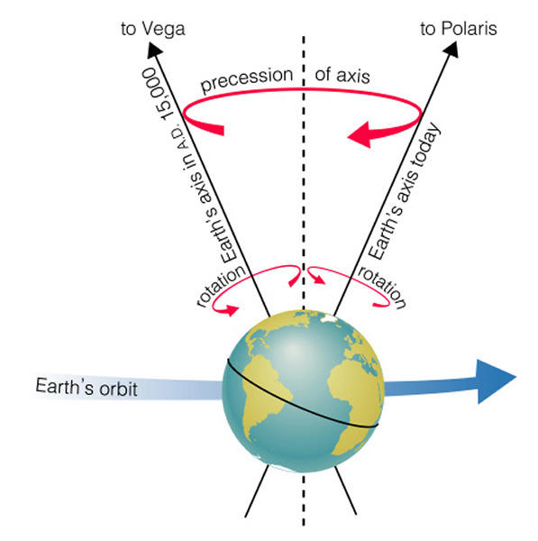
Precession
Property of something spinning (angular momentum) experiencing a force
https://people.highline.edu/iglozman/classes/astronotes/cycles.htm

Slide 7
Proton precession
Frequency, $ω=γB_{0}$
3T: $ω$~128 MHz
7T: $ω$~298 MHz
Radio frequencies (RF)

Slide 8
Magnetic Resonance key points
Polarisation – net magnetisation M
Excitation – move away from z axis
Precession – M ar0und B₀
Measure
Relaxation

Slide 9
Excitation
Apply “RF pulse” to rotate magnetisation away from z
RF pulse has same frequency as the precession
Can change duration and magnitude of RF pulse to determine “flip angle”, e.g. 90 degrees
z
x
y

Slide 10
Precession
A changing magnetic field in x-y plane → measure
William Overall

Slide 11
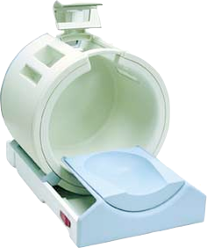
Measure
A changing magnetic field
→ Induces a voltage in coil of conducting wire

Slide 12
Measure
A changing magnetic field in x-y plane
Signal strength

Slide 13
Relaxation
Two independent components:
T2: decay of x-y component
Measurable signal decays ~ <100 ms
T1: regrowth of z component
Net M_{z} reforms ~ 1-5 sec

Slide 14
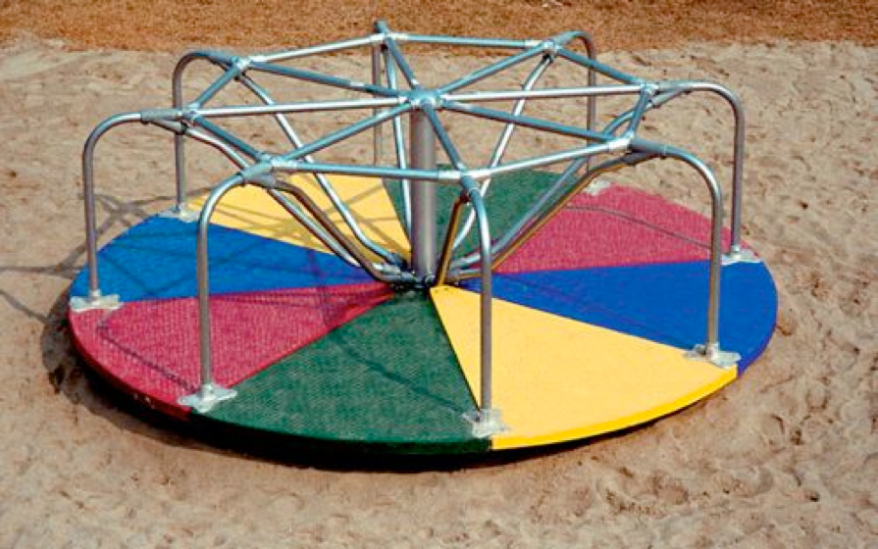
Rotating frame
If we watch the precession of M while also spinning around the z axis at same frequency… then M appears still

Slide 15
T2 relaxation
In rotating frame
Spins experience inhomogeneous field (created by neighbours) and “dephase”

Slide 16
T2 relaxation
Net magnetisation (x-y component only)

Slide 17
T1 & T2 relaxation
T1
T2

Slide 18
Contrast
T2 decay of M_{xy}
T1 regrowth of M_{z}
T2 values:
WM = 75 ms
GM = 83 ms
T1 values:
WM = 850 ms
GM = 1550 ms

Slide 19
Inversion Recovery
Excite here!

Slide 20
Inversion recovery – T1 contrast

Slide 21
Magnetic Resonance key points
Polarisation – net magnetisation M
Excitation – supply energy with RF pulse
Precession – M ar0und B₀
Measure – changing magnetic field
Relaxation – decay of M in x-y, regrowth of M in z

Slide 22
Spatial encoding
Field gradients
$$ω=γB$$

Slide 23
Spatial encoding
Field gradients
$$ω(x)=γB(x)$$

Slide 24
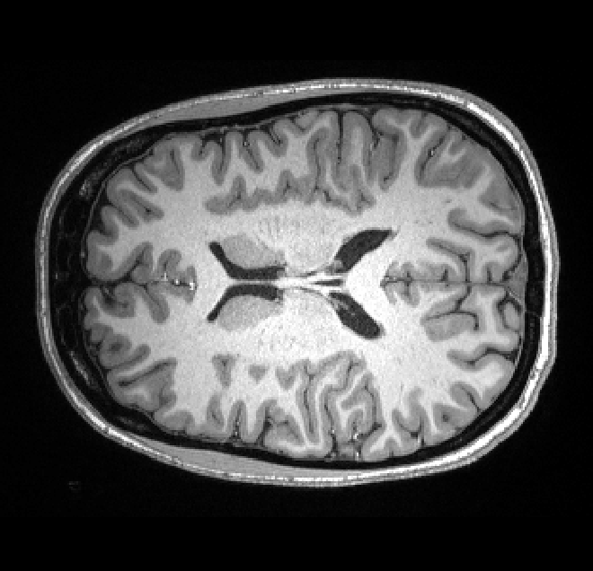
Magnetic Resonance Imaging
Polarisation
Excitation
Precession
Spatial encoding
Measure
Relaxation
Repeat, varying gradients
2D Inverse
Fourier Transform

